Slide 1
Introduction to Matlab
& Data Analysis
Lecture 11:
Data handling tips and Quality Graphs
Maya Geva, Weizmann 2011 ©

Slide 2

Why use matlab for your data analysis?
One interface for all stages of your work -
  View raw data
  Manipulate it with statistics\signal processing\etc.
  (automate your scripts to go over multiple data files)
  Make quality and reproducible graphs

Slide 3
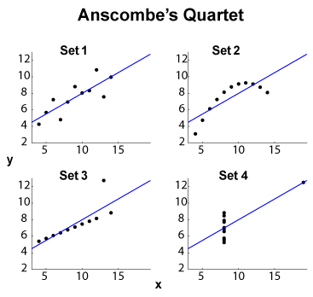
First step – view raw data
Graphics reveal Data…
4 sets of {x,y} data points
mean and variance of {x} and {y} is equal
correlation coefficient too
regression line, and error of fit using the line are equal too…
F.J. Anscombe, American Statistican, 27 (1973)

Slide 4
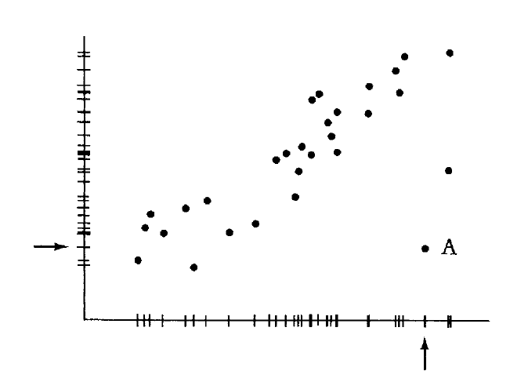
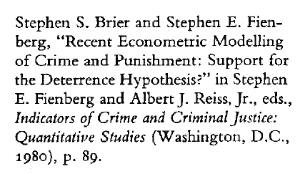
One more example
See how A jumps out in the plot but blends in the marginal distribution

Slide 5
View your data – Look for interesting events
a1 = = subplot(2,1,1)
…
a2 = subplot(2,1,2)
…
plot()
Live demonstration…

Slide 6
Use interactive modes
[x,y] = ginput(N)
Comes in handy when you’re interested in a few important points in your plot
A very useful method for extracting data out of published images

Slide 7
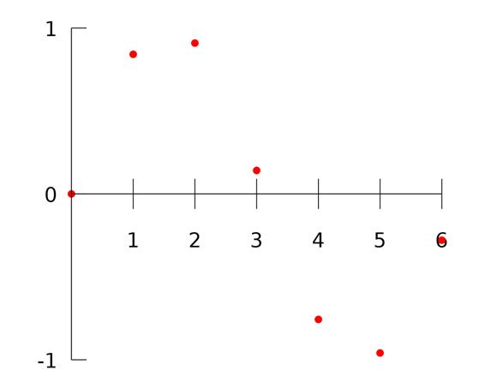
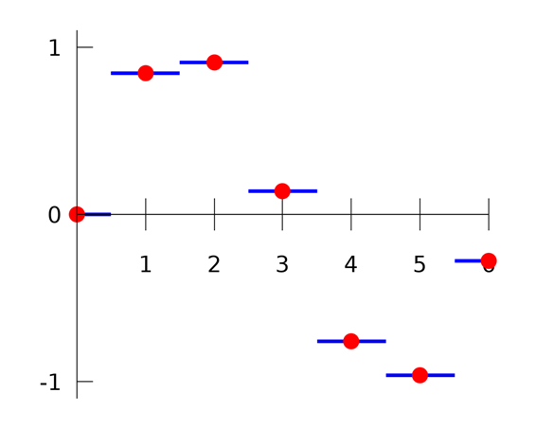
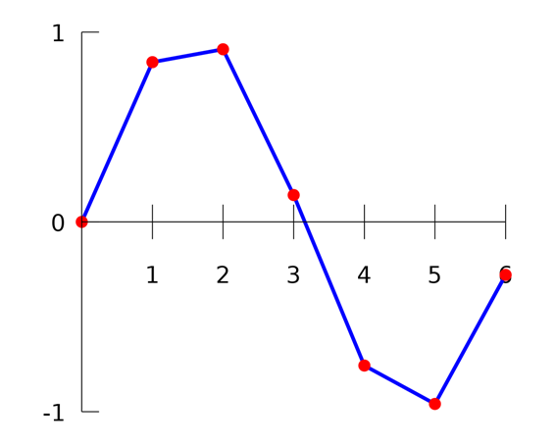
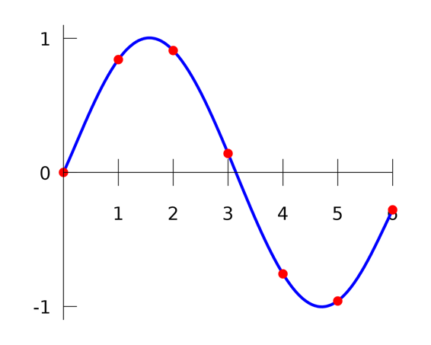
Having limited data – filling in the missing points

Slide 8
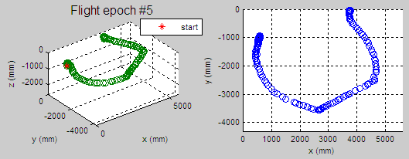
Fill in missing data
Using simple interpolation (table lookup):
interp1( measured sample times, measured samples, new time vector, 'linear', NaN );
Other interpolation options – ‘cubic’, ‘spline’ etc.
Notes:
Use NAN\0 for out of range values

Slide 9
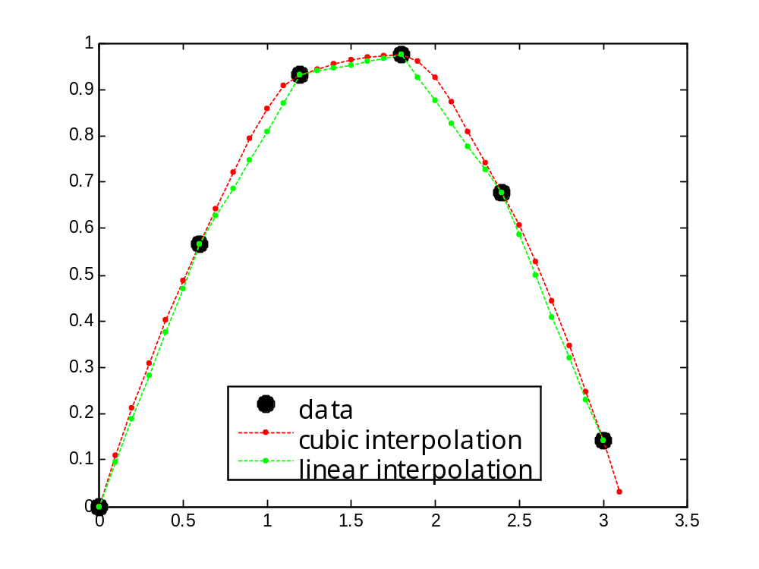
Example - interpolation
x = 0:.6:pi;
y = sin(x);
xi = 0:.1:pi;
figure
yi = interp1(x,y,xi,'cubic');
yj = interp1(x,y,xi,'linear');
plot(x,y,'ko')
hold on
plot(xi,yi,'r:')
plot(xi,yj,'g.:')

Slide 10
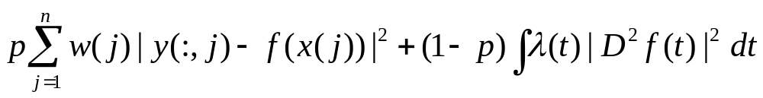
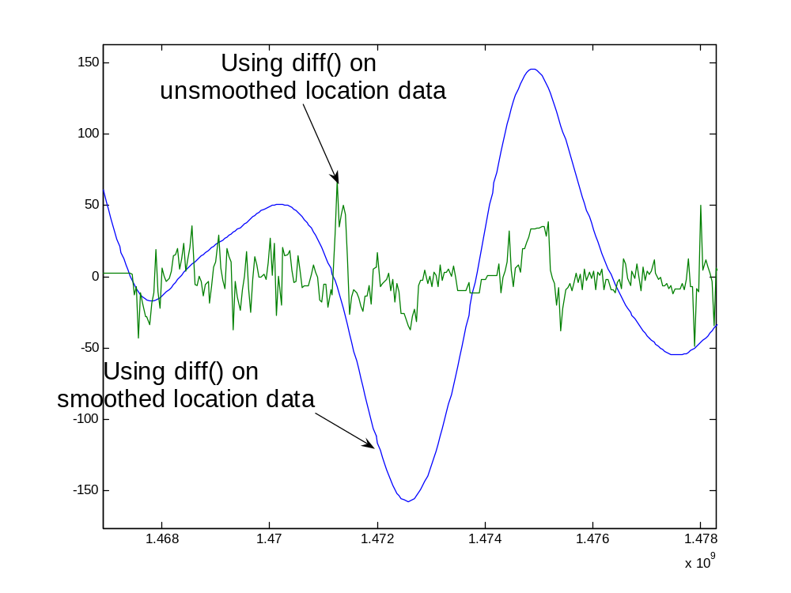
Smooth your data if needed – spline toolbox
This smoothing spline minimizes -
csaps(x,y,p)
Experiment till you find the right p to use (the function can give you an initial guess if you don’t know where to begin)

Slide 11
“There are three kinds of lies: lies, damned lies, and statistics “
Exploratory data analysis
(Almost) Everything you’re used to doing with your favorite statistics software (spss etc.) is possible to do under the Matlab’s rooftop*
* you’ll might have to work a bit harder to code the specific tests you’ve got ready in spss – you can always look for other people’s code in Mathworks website
Hypothesis testing
Notes:
The term was popularized in the United States by Mark Twain, who attributed it to the 19th Century British Prime Minister Benjamin Disraeli.

Slide 12
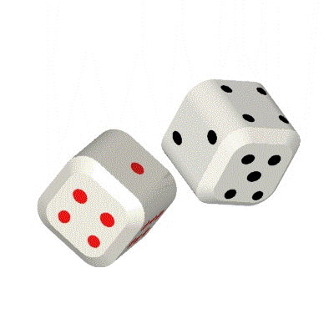
Random number generators
rand(n) - n uniformly distributed numbers between [0,1]
Multiply and shift to get any range you need
randn(n) - Normally distributed random numbers – mean = 0, STD = 1
Multiply and shift to get the mean and STD you need
For: Mean = 0.6, Variance = 0.1:
x = .6 + sqrt(0.1) * randn(n)

Slide 13
Example –
Implementing coin-flips in Matlab
p = rand(1);
If (p>0.5)
  Do something
Else
  Do something else
end

Slide 14
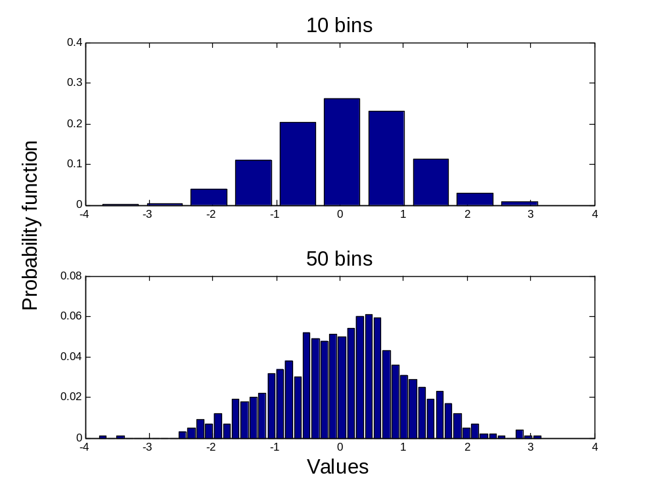
Histograms 1D
X = randn(1,1000);
[C, N] = hist(X, 50);
bar(N,C/sum(C))
(N = location of bins,
C = counts in each location)
[C, N] = hist(X, 10);
bar(N,C/sum(C))

Slide 15
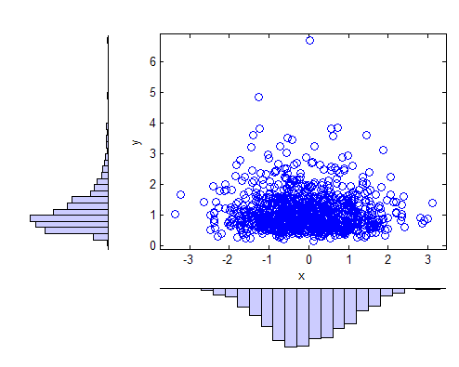
Histograms 2D
x = randn(1000,1);
y = exp(.5*randn(1000,1));
scatterhist(x,y)
Allows viewing correlations
in your data

Slide 16
Basic Characteristics of your data:
mean
std
median
max
min
How to find the 25% percentile of your data?
Y = prctile(X,25)
Notes:
Note – 1 --> N dimensions

Slide 17
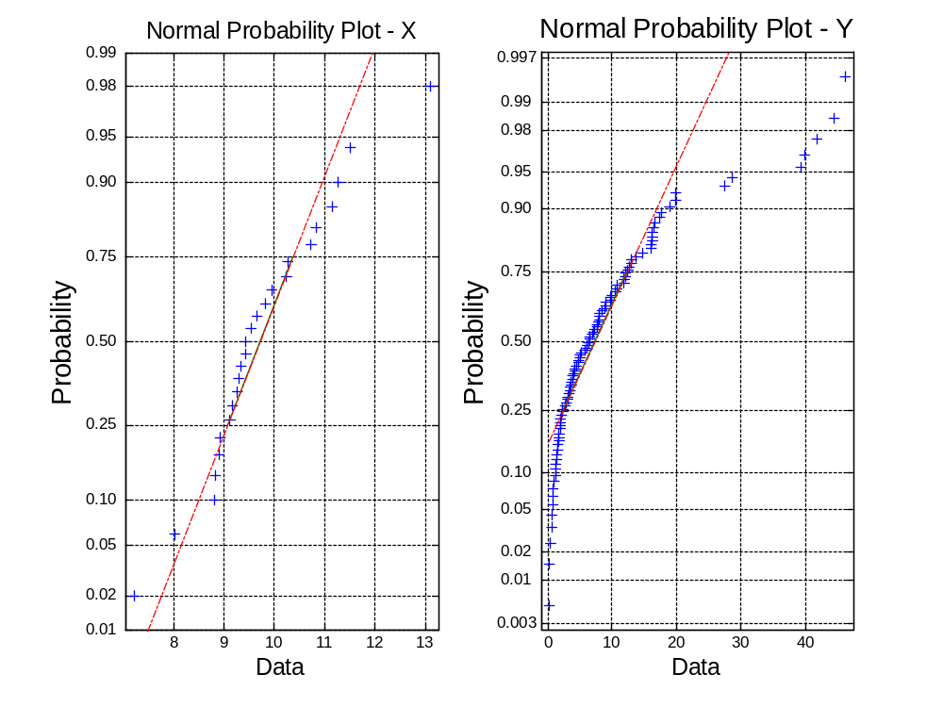
Is your data Gaussian?
x = normrnd(10,1,25,1);
normplot(x)
y = exprnd(10,100,1);
normplot(y)

Slide 18
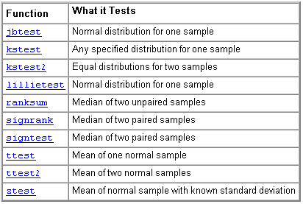
Statistics toolbox - Hypothesis Tests

Slide 19
It’s not always easy to prove your data is Gaussian
If you’re sure it is – you can use the parametric tests in the toolbox
Remember – that one of the parametric tests has an un-parametric version that can be used:
ttest → ranksum, signrank
anova → kruskalwallis
These tests work well when your data set is large, otherwise – use precaution

Slide 20
Analysis of Variance
One way – anova1
Two way – anova2
N-way – anovan
What is ANOVA?
In its simplest form ANOVA provides a statistical test of whether or not the means of several groups are all equal, and therefore generalizes t-test to more than two groups.
(Doing multiple two-sample t-tests would result in an increased chance of committing a type I error.)
Notes:
Notice that anovan can be used for 1-way, 2-way etc.
The purpose of one-way ANOVA is to find out whether data from several groups have a common mean. That is, to determine whether the groups are actually different in the measured characteristic.

Slide 21
Example - one way ANOVA
Using data-matrix – “hogg”
hogg = [24 14 11 7 19;
15 7 9 7 24;
21 12 7 4 19;
27 17 13 7 15;
33 14 12 12 10;
23 16 18 18 20]
The columns - different shipments of milk (Hogg and Ledolter (1987) ).
The values in each column represent bacteria counts from cartons of milk chosen randomly from each shipment.
Do some shipments have higher counts than others?
[p,tbl,stats] = anova1(hogg);

Slide 22
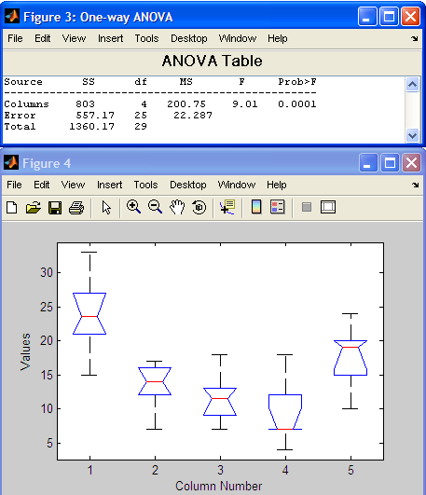
Using ANOVA
P-value
Sums of squares
box plot()
Degrees of freedom
Confidence interval
mean squares (SS/df)
F statistic
25-75 percentiles
median
Data range
Notes:
The ANOVA table has six columns:
The first shows the source of the variability.
The second shows the Sum of Squares (SS) due to each source.
The third shows the degrees of freedom (df) associated with each source.
The fourth shows the Mean Squares (MS) for each source, which is the ratio SS/df.
The fifth shows the F statistic, which is the ratio of the MS's. –
F=(found variation of the group averages)/(expected variation of the group averages)
The sixth shows the p-value, which is derived from the cdf of F. As F increases, the p-value decreases.
You can use the F statistic to do a hypothesis test to find out if the bacteria counts are the same. anova1 returns the p value from this hypothesis test. In this case the p value is about 0.0001, a very small value. This is a strong indication that the bacteria counts from the different shipments are not the same. An F statistic as extreme as the observed F would occur by chance only once in 10,000 times if the counts were truly equal.
in a notched box plot the notches represent a robust estimate of the uncertainty about the medians for box-to-box comparison. Boxes whose notches do not overlap indicate that the medians of the two groups differ at the 5% significance level.
Whiskers extend from the box out to the most extreme data value within whis*iqr, where whis is the value of the 'whisker' parameter and iqr is the interquartile range of the sample.

Slide 23
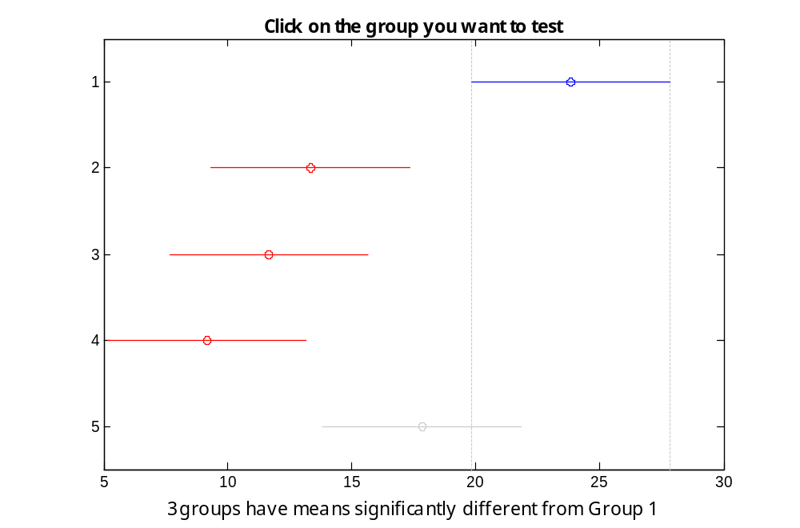
Using ANOVA
Many times it comes handy to perform multiple comparisons on the different data sets - multcompare(stats)
Allows interactively using the ANOVA result
Notes:
Sometimes you need to determine not just whether there are any differences among the means, but specifically which pairs of means are significantly different. It is tempting to perform a series of t tests, one for each pair of means, but this procedure has a pitfall. In a t test, you compute a t statistic and compare it to a critical value. The critical value is chosen so that when the means are really the same (any apparent difference is due to random chance), the probability that the t statistic will exceed the critical value is small, say 5%. When the means are different, the probability that the statistic will exceed the critical value is larger. In this example there are five means, so there are 10 pairs of means to compare. It stands to reason that if all the means are the same, and if there is a 5% chance of incorrectly concluding that there is a difference in one pair, then the probability of making at least one incorrect conclusion among all 10 pairs is much larger than 5%. Fortunately, there are procedures known as multiple comparison procedures that are designed to compensate for multiple tests.

Slide 24
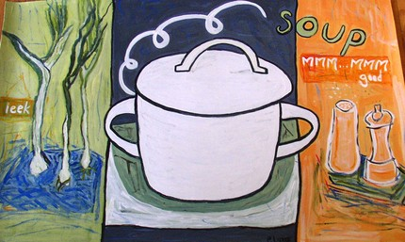
There’s a lot more you can do with your data
Signal Processing Toolbox –
  Filter out specific frequency bands:
    Get rid of noise
    Focus on specific oscillations
  Calculate cross correlations
  View Spectograms
  And much more…

Slide 25
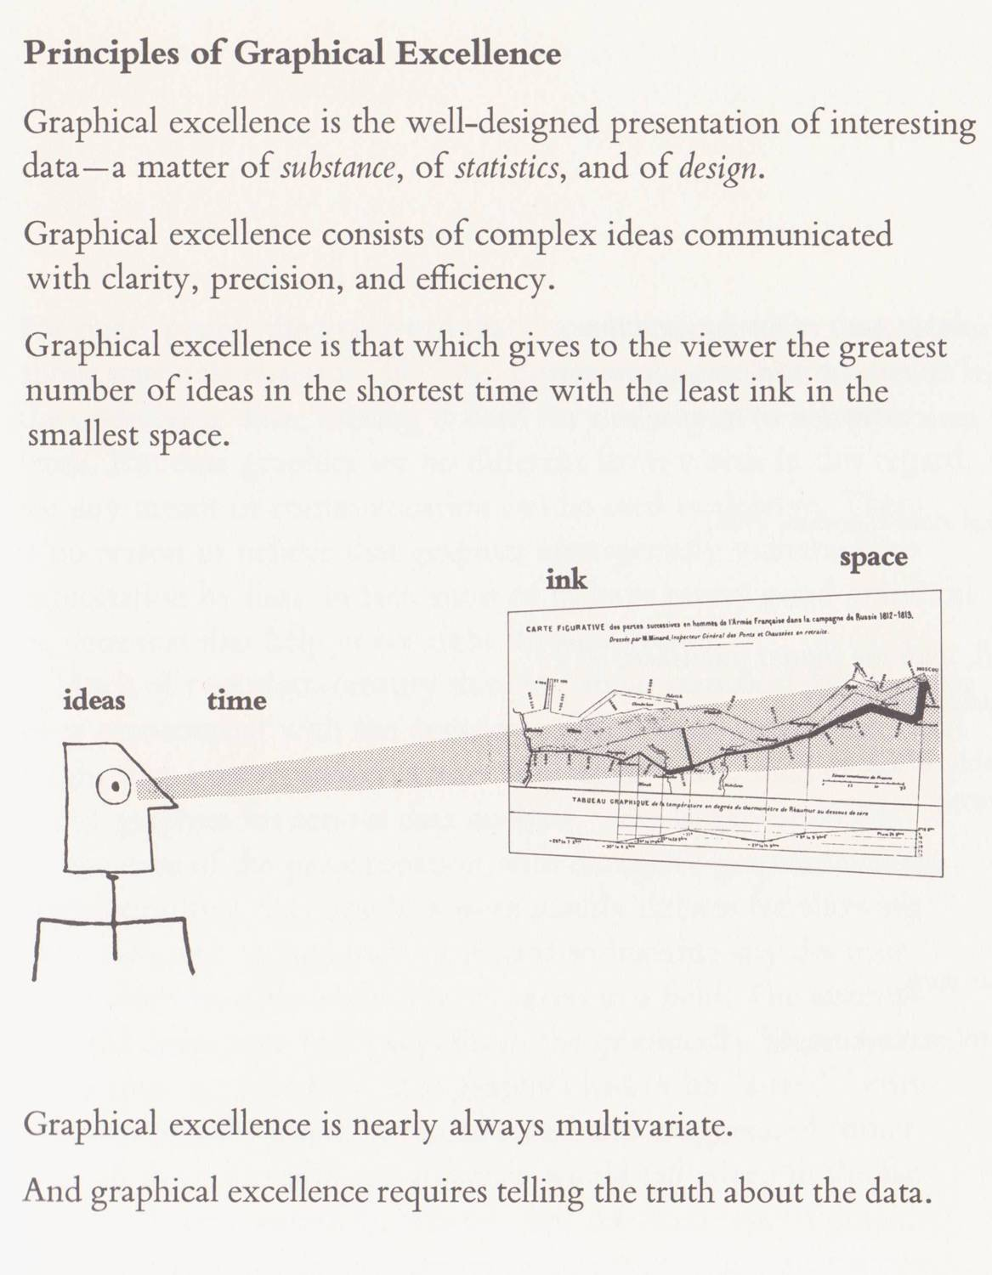
“The visual Display of Quantitative Information” and
“Envisioning Information”
\Edward Tufte

Slide 26
Making Quality Graphs for publications in Matlab
No need to waste time on importing data between different software
Update data in a simple re-run
Learn how to control the fine details

Slide 27
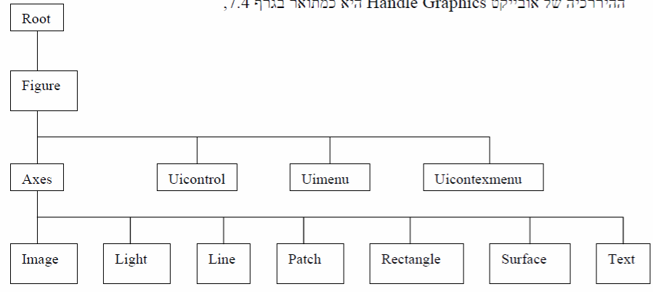
Graphics Handles Hierarchy

Slide 28
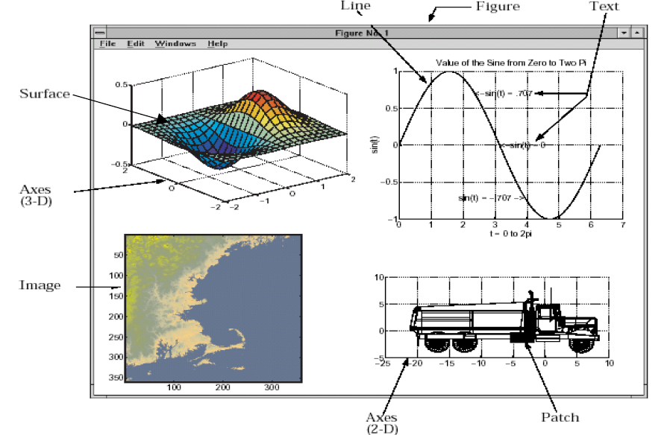
Example of the different components of a graphic object

Slide 29
Reminder
gcf – get handle of current figure
gca – get handle of current axes
set
  set(gca,'Color','b')
get(h)
  returns all properties of the graphics object h

Slide 30
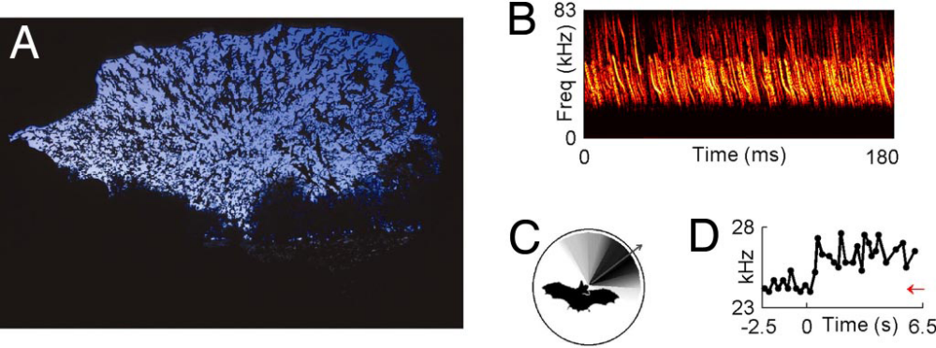
Rules for Quality graphs
If you want to really control your graph – don’t limit yourself to subplot, instead – place each subplot in the exact location you need -
  axes('position', [0.09 , 0.38 , 0.28 , 0.24]); %[left, bottom, width, height]
Ulanovsky, Moss; PNAS 2008

Slide 31
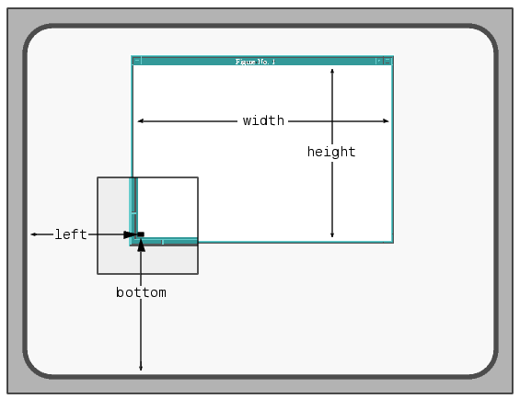
The position vector
[left, bottom, width, height]
Notes:
set(gca,'Units')
[ inches | centimeters | {normalized} | points | pixels ]

Slide 32
write a template that allows control of every level of your figure
Outline - Define the shape and size of your figure
A
B
A
C
B
Subplot A)
define axes size and location inside the figure
C
Load data, decide on plot type and add supplementary items (text, arrows etc.)
Subplot B)
define axes size and location inside the figure
Load data, decide on plot type and add supplementary items (text, arrows etc.)
…

Slide 33
Preparing the starting point
Outline - Define the shape and size of your figure
figure
set(gcf,'DefaultAxesFontSize',8);
set(gcf,'DefaultAxesFontName','helvetica');
set(gcf,'PaperUnits','centimeters','PaperPosition',[0.2 0.2 8.3 12]); %[left, bottom, width, height]
Many more options to control your general figure size…
Notes:
'PaperPosition = A rectangle that determines the location of the figure on the printed page

Slide 34
Use the appropriate graph function to optimally view different data types
2D graphs:
Plot
plotyy
Semilogx / semilogy
Loglog
Area
Fill
Pie
bar/ barh
Hist / histc / staris
Stem
Errorbar
Polar / rose
Fplot / ezplot
Scatter
Image / imagesc /pcolor/imshow
3D graphs:
Plot3
Pie3
Mesh / meshc / meshz
Surf / waterfall / surfc
Contour
Quiver
Fill3
Stem3
Slice
Scatter3

Slide 35
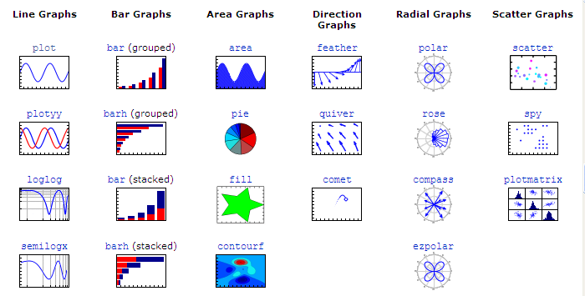
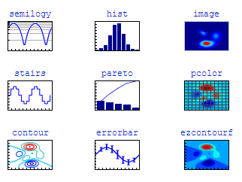
2D Plots

Slide 36
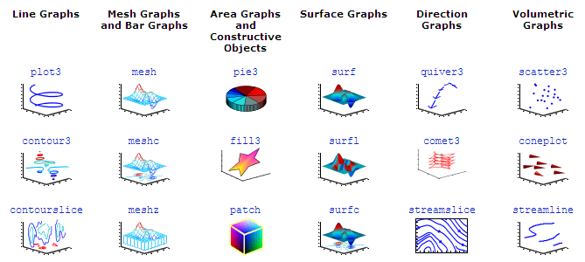
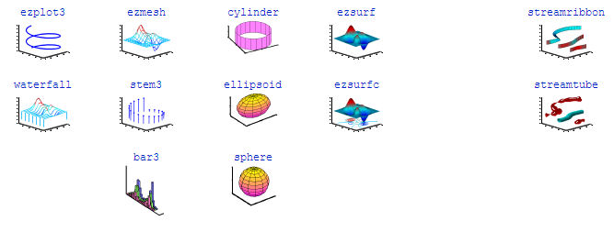
3D Plots

Slide 37
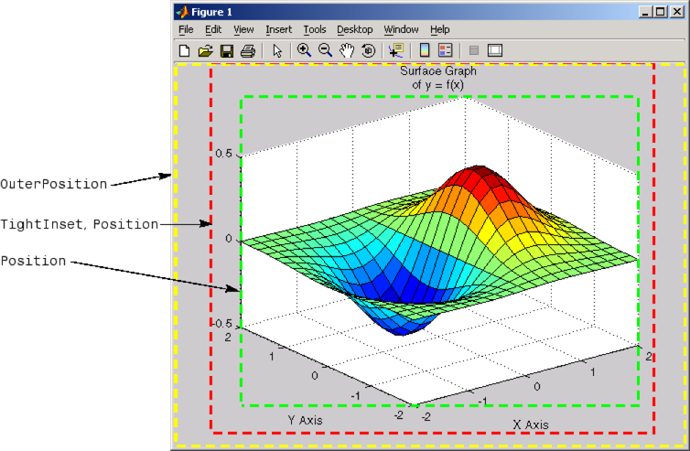
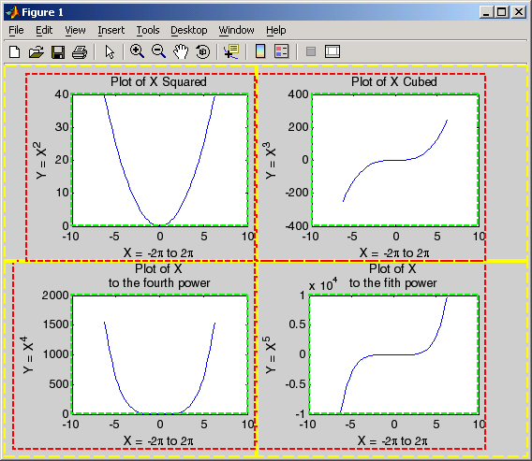
Positioning Axes

Slide 38
Try to create a clear code that will enable fine tuning
Subplot A)
define axes size and location inside the figure
a1 = axes('position', [0.14 , 0.08 , 0.8 , 0.5]);
Specify the source of the data –
  load()
Plot the data with your selected function
Specify the axes parameters clearly –
  xlimits = [0.7 4.3];
  xticks = 1 : 4 ;
  ylimits = [-28 2];
  yticks = [-28 0];
xlimits and ylimits will later be used as your reference point to place text and other attributes on the figure
Load data, decide on plot type and add supplementary items (text, arrows etc.)

Slide 39
Specify the location of every additional attribute in the code
Use text() to replace title(), xlabel(), ylabel() – it will give you a better control on exact location
line(), rectangle()
annotation():
  line
  arrow
  doublearrow (two-headed arrow)
  textarrow (arrow with attached text box), textbox
  ellipse
  Rectangle
If you want your graphic object to pass outside Axes rectangle – use the ‘Clipping’ property –
line(X,Y,…,’Clipping’,’off’)

Slide 40
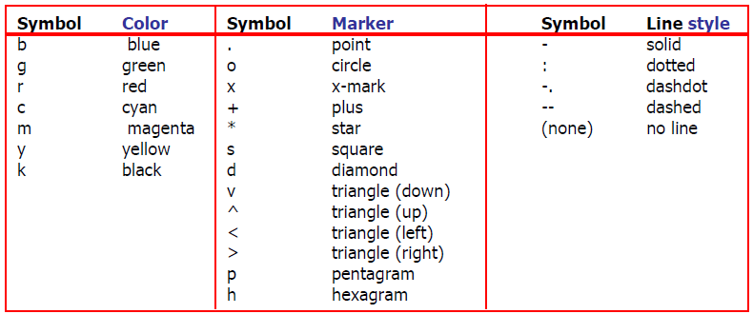
Line attributes
Control line and marker attributes –
plot(x,y,'--rs','LineWidth',2, 'MarkerEdgeColor','k',...
'MarkerFaceColor','g', 'MarkerSize',10)
Colors can be picked out from all palette by using [R G B] notation
Notes:
produce a graph with the following specifications -
A red dashed line with square markers
A line width of two points
The edge of the marker colored black
The face of the marker colored green
The size of the marker set to 10 points

Slide 41
God is in the details
set( gca, 'xlim', xlimits, 'xtick', xticks, 'ylim', ylimits, 'ytick',… [ylimits(1) 0 ylimits(2)], 'ticklength', [0.030 0.030], 'box', 'off' );
% Set the limits and ticks you defined earlier
line( xlimits, [0 0], 'color', 'k', 'linewidth', 0.5 );
% Place line at y = 0
text( xlimits(1)-diff(xlimits)/2.8, ylimits(1)+diff(ylimits)/2.0,… {'\Delta Information', '(bits/spike)'}, ‘fontname', 'helvetica',… 'fontsize', 7, 'rotation', 90, 'HorizontalAlignment', 'center' );
% Instead of using ylabel – use a relative placement technique

Slide 42
Use any symbols you need
Greek Characters:
  \alpha, \beta, \gamma …
Math Symbols –
  \circ ◦, \pm ± …
Font
  Bold \bf, Italic \it
  Superscript x^5, Subscript – x_5
Notes:
Default interperter

Slide 43
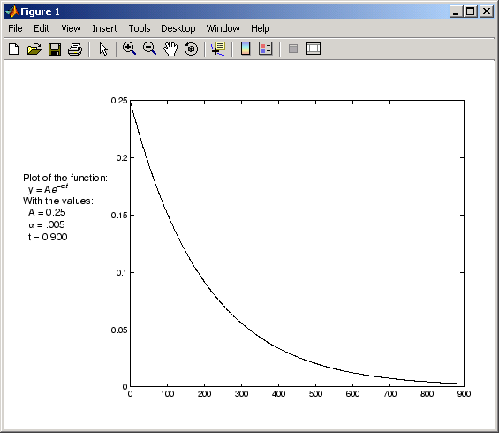
Example – multiple axes on same plot
h = axes('Position',[0 0 1 1],'Visible','off');
axes('Position',[.25 .1 .7 .8])
Plot data in current axes -
t = 0:900;
plot(t,0.25*exp(-0.005*t))
Define the text and display it in the full-window axes:
str(1) = {'Plot of the function:'};
str(2) = {' y = A{\ite}^{-\alpha{\itt}}'};
str(3) = {'With the values:'};
str(4) = {' A = 0.25'};
str(5) = {' \alpha = .005'};
str(6) = {' t = 0:900'};
set(gcf,'CurrentAxes',h)
text(.025,.6,str,'FontSize',12)

Slide 44
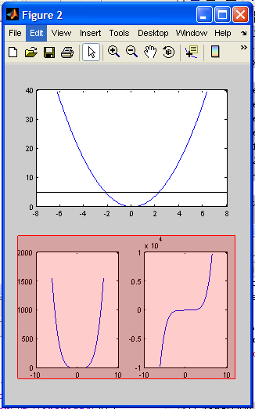
Example
% Prepare three plots on one figure -
x = -2*pi:pi/12:2*pi;
subplot(2,2,1:2)
plot(x,x.^2)
h1=subplot(2,2,3);
plot(x,x.^4)
h2=subplot(2,2,4);
plot(x, x.^5)
% Calculate the location of the bottom two -
p1 = get(h1,'Position');
t1 = get(h1,'TightInset');
p2 = get(h2,'Position');
t2 = get(h2,'TightInset');
x1 = p1(1)-t1(1); y1 = p1(2)-t1(2);
x2 = p2(1)-t2(1); y2 = p2(2)-t2(2);
w = x2-x1+t1(1)+p2(3)+t2(3); h = p2(4)+t2(2)+t2(4);
% Place a rectangle on the bottom two, a line on the top one
annotation('rectangle',[x1,y1,w,h],...
'FaceAlpha',.2,'FaceColor','red','EdgeColor','red');
line( [-8 8], [5 5], 'color', 'k', 'linewidth', 0.5 );
Margin added to Position to include labels and title

Slide 45
Save your graph
First Option :
saveas(h,'filename','format')
Second (better for printing purposes)
eval(['print ', figure_name_out, ' -f', num2str(gcf), ' -depsc -cmyk']);
% Photoshop format
eval(['print ', figure_name_out, ' -f', num2str(gcf), ' -dpdf -cmyk']);
        % PDF format
The publishing industry uses a standard four-color separation (CMYK) and not the RGB.

Slide 46
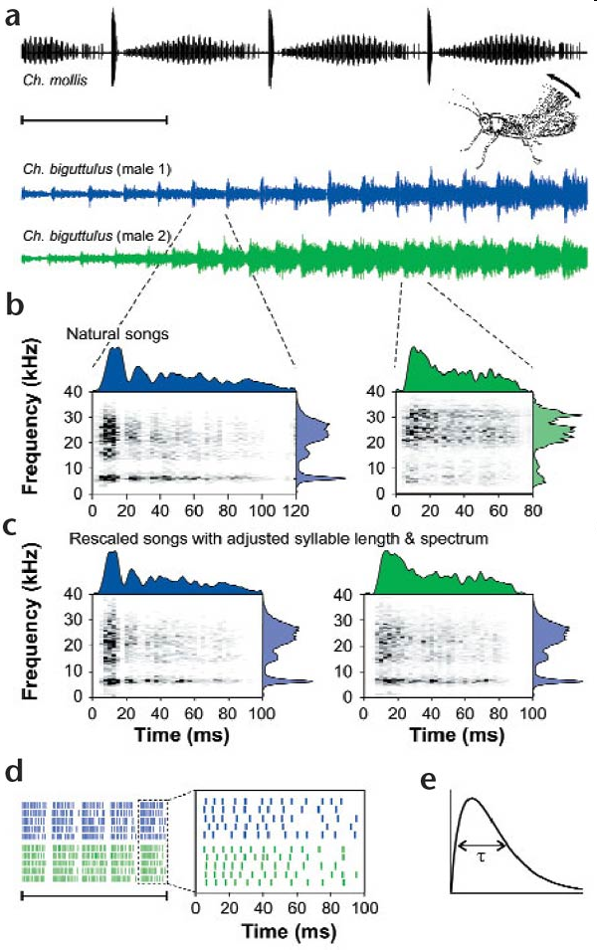
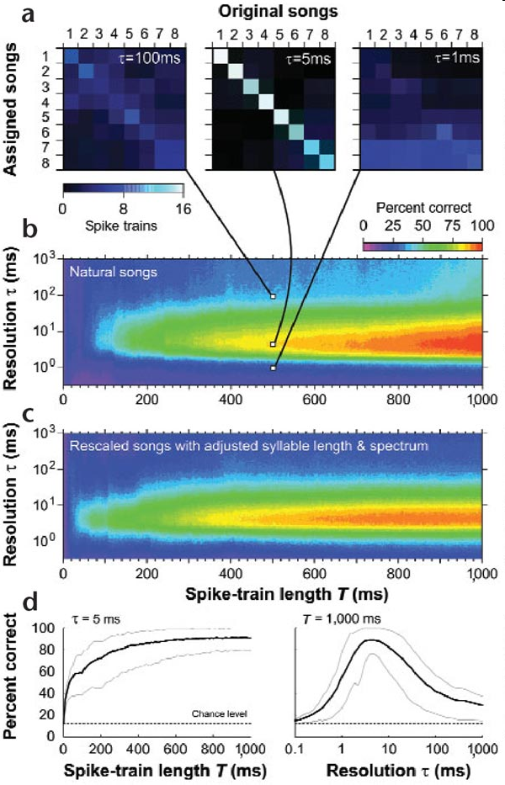
Single auditory neurons rapidly discriminate conspecific communication signals, Machens et al., Nature Neurosci. (2003).
Test Yourself – Can you reproduce these figures?
Fig.1
Fig.2

Slide 47
Pros and Cons For Preparing Graphs for Publication in Matlab
Cons
It might take you a long time to prepare your first “quality figure” template
Pros
All the editing rounds will be much faster and robust than you’re used to –
  Changing the data
  Adding annotations
  Changing the figure size

Slide 48
Example – making a raster plot
A = full(data_extracellular_A1_neuron__SparseMatrix); % convert from sparse to full
% Plot a line on each spike location
[M, N] = size(A);
[X,Y] = meshgrid(1:N,0:M-1);
Locations_X(1,:) = X(:);
Locations_X(2,:) = X(:);
Locations_Y(1,:) = [Y(:)*4+1].*A(:);
Locations_Y(2,:) = [Y(:)*4+3].*A(:);
indxs = find(Locations_Y(1,:) ~= 0);
Locations_X = Locations_X(:,indxs);
Locations_Y = Locations_Y(:,indxs);
figure
line(Locations_X,Locations_Y,'LineWidth',4,'Color','k')

Slide 49
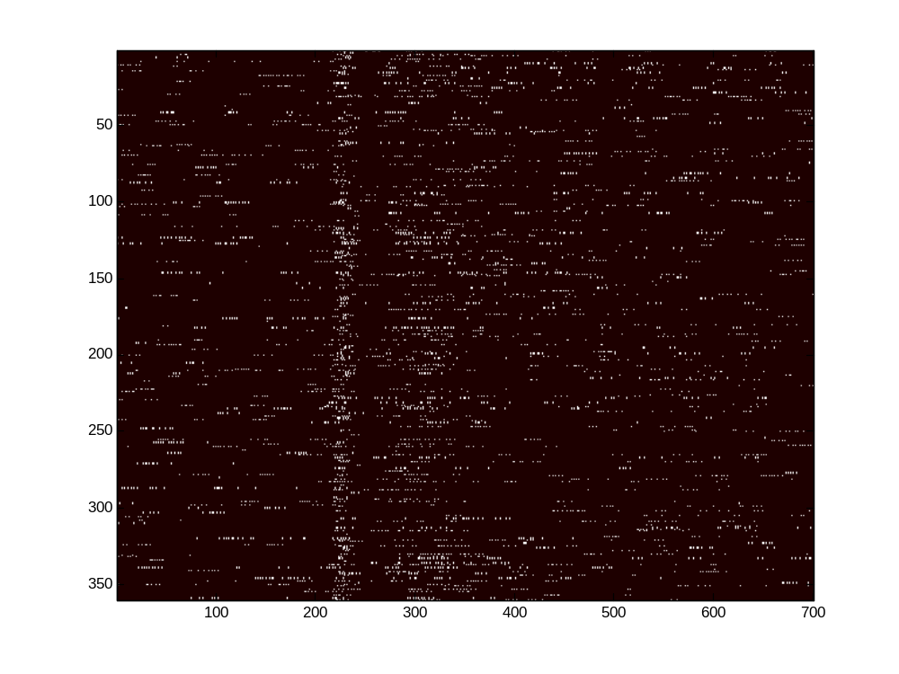
First option – using imagsc
Display axes border

Slide 50
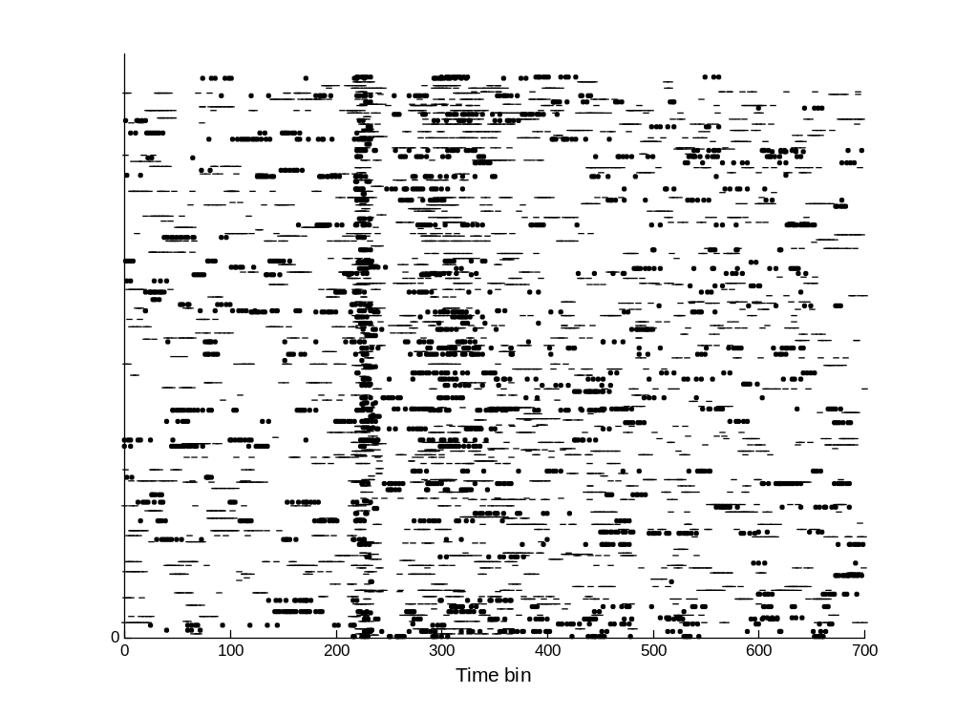
placing lines in each spike location:

